Slide 1
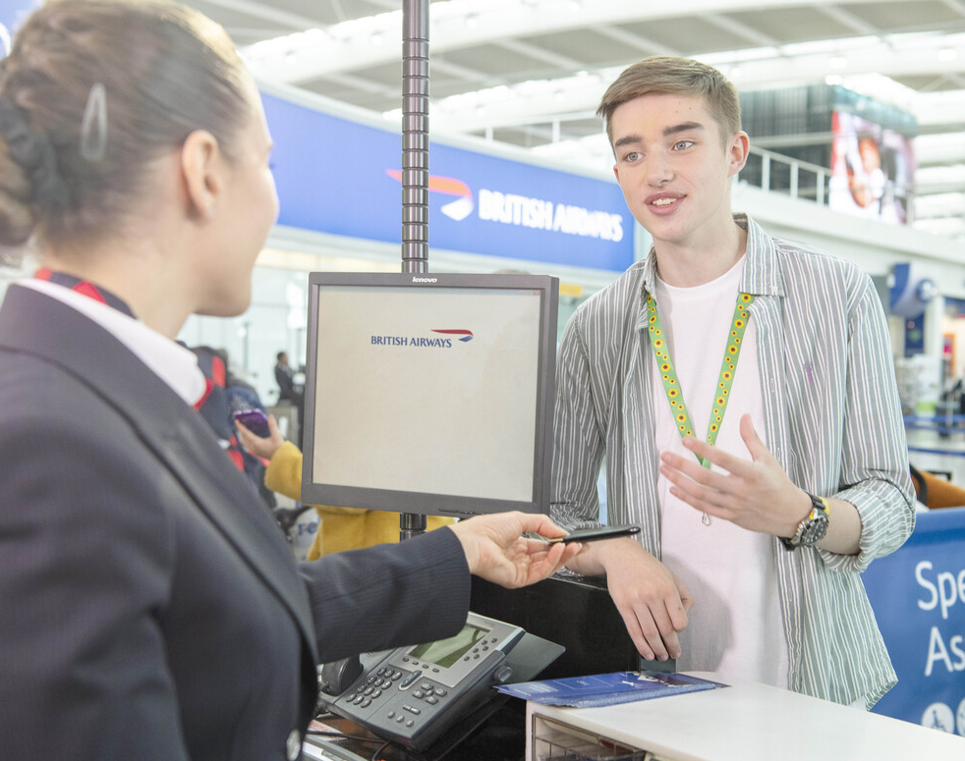
British Airways
Predicting customer buying behaviour

Slide 2
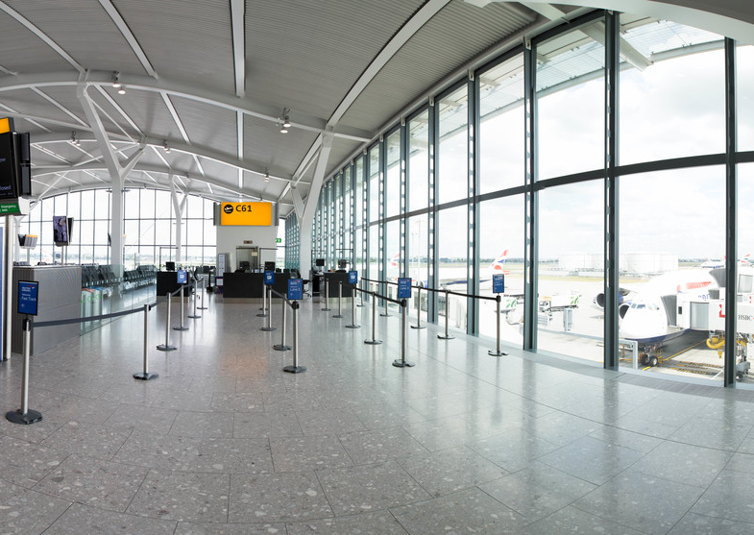
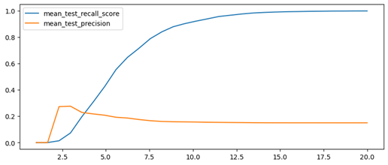
Customer Predictive Analysis
The more the services requested by the customer, the more the customer is likely to purchase a ticket in the future up to an point where the prospective sales would remain constant.

